Slide 1
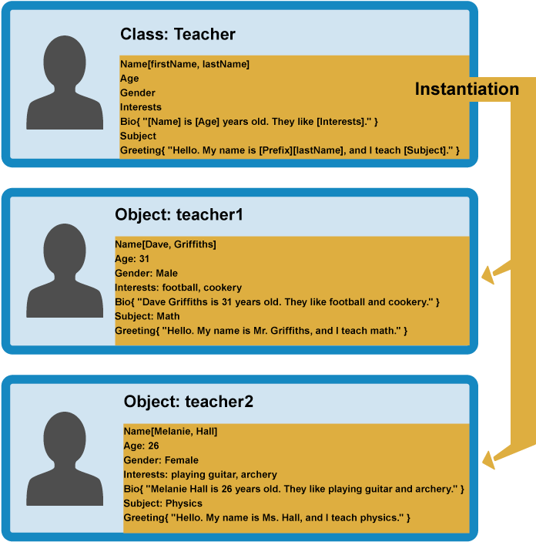
TypeScript OOP
Classes, inheritance, abstraction
SoftUni Team
Technical Trainers
Software University
http://softuni.bg

Slide 2
Table of Content
Classes in TypeScript
Properties
Methods
Access modifiers
Inheritance
Accessors
Abstraction
Static properties

Slide 3
Have a Question?
sli.do
#tbd

Slide 4

TypeScript Classes

Slide 5
Definition
Classes in TypeScript can contain:
Data, defined by its properties
Who can use the data - access modifiers
Some actions by using methods
One class may have many heirs – inheritance
Abstract classes cannot be instantiated directly. They are the ancestor class which starts the inheritance chain

Slide 6
Overview
class Dog {
private name: string;
private age: number;
constructor(n: string, a: number) {
this.name = n;
this.age = a;
}
bark() {
return `${this.name} woofed friendly`;
}
}
let tommy = new Dog('Tommy', 6);
console.log(tommy); //Dog { name: 'Tommy', age: 6 } console.log(tommy.bark()); //Tommy woofed friendly
Class initialization
Class properties
Class constructor
Class method

Slide 7
Breakdown: Properties
The properties in TypeScript are used to store data
They are defined before the constructor in the body of the class
The data is passed to them afterwards
class ContactList {
private name: string;
private email: string;
private phone: number; }
Property declarations
Notes:
Виж твоите примери са много големи и не се събират - кутийките застъпват кръгчето. Най- най- малкия шрифт в презентацията ти трябва да е 20 и това е в краен скучай иначе 24. На булетите шрифта е 34-36 и на всеки вътрешен булет с 2 по-малко

Slide 8
Breakdown: Constructor
The constructor is used to give properties values
Each class can have only one constructor
The constructor creates new object with the defined properties
class ContactList {
//property declarations constructor(n: string, e: string, p: number) {
this.name = n;
this.email = e;
this.phone = p;
}
}
Constructor
Notes:
Виж твоите примери са много големи и не се събират - кутийките застъпват кръгчето. Най- най- малкия шрифт в презентацията ти трябва да е 20 и това е в краен скучай иначе 24. На булетите шрифта е 34-36 и на всеки вътрешен булет с 2 по-малко

Slide 9
Breakdown: Methods
The methods are used to define functionalities
Each class can have lots of methods
Generally speaking, each method should do one thing only
class ContactList {
//property declarations
//constructor call() {
return `Calling Mr. ${this.name}`
}
showContact() {
return `Name: ${this.name} Email: ${this.email} Number: ${this.phone}`
}
}
Methods
Notes:
Виж твоите примери са много големи и не се събират - кутийките застъпват кръгчето. Най- най- малкия шрифт в презентацията ти трябва да е 20 и това е в краен скучай иначе 24. На булетите шрифта е 34-36 и на всеки вътрешен булет с 2 по-малко

Slide 10
Access modifiers
Unlike JavaScript, TypeScript has access modifiers
Used to define who can use the class elements
Types of access modifiers:
Public
Private
Readonly
Protected

Slide 11
Public
By default each element is defined as public
Gives access to the element
Not only properties may be public, but constructors as well
class Zoo {
public type: string;
public name: string;
public constructor(t: string, n: string) {
this.type = t;
this.name = n;
}
}

Slide 12
Private
Element marked as private cannot be accessed outside the declaration
class Zoo {
private type: string;
private name: string;
constructor(t: string, n: string) {
this.type = t;
this.name = n;
}
}
let animal = new Zoo('bear', 'Martha');
console.log(animal.name); //Error: name is private.

Slide 13
Readonly
Readonly protects the value from being modified
No unexpected data mutation
class Zoo {
readonly name: string;
constructor(n: string) {
this.name = n;
}
}
let animal = new Zoo('Martha');
animal.name = 'Thomas'; //Error: name is read-only.

Slide 14
Protected
Element marked as protected can be accessed only within the declaration class and the subclasses
class Zoo {
protected name: string;
constructor(n: string) { this.name = n; }
}
class Bear extends Zoo {
private color: string;
constructor (name, c: string) {
super(name);
this.color = c;
}
}
let martha = new Bear('Martha', 'Brown');

Slide 15
Inheritance
Used to extend existing classes to new ones
To do so we use the extend key word
The "basic" class is often called superclass and the extended - subclasses
To inherit the superclass's constructor to the subclass we use the keyword super

Slide 16
Example of inheritance
class Company {
public name: string; constructor(n: string) { this.name = n; }
}
class Department extends Company {
private depName: string; constructor(name, dN) {
super(name);
this.depName = dN;
}
}
class Employee extends Department {
//Some code logic
}
Class Department inherits the Company class
Class Employee inherits the Department class

Slide 17
Inheritance
Not only properties might be inherited, but methods as well.
class Vehicle {
public color: string;
constructor(c: string) { this.color = c; }
showColor() { return `The car is ${this.color}`; }
}
class PassengerCar extends Vehicle {
public model: string;
constructor(color, m: string) {
super(color);
this.model = m;
}
details() {
return `${super.showColor()} and is ${this.model}`
}
}

Slide 18
Accessors
In order to use accessors your compiler output should be set to ES6 or higher
Get and Set
Get method comes when you want to access any class property
Set method comes when you want to change any class property

Slide 19
Example of accessors
const fullNameMaxLength = 10;
class Employee {
private _fullName: string;
get fullName(): string {
return this._fullName;
}
set fullName(newName: string) {
if (newName && newName.length > fullNameMaxLength) {
throw new Error("fullName has a max length of " + fullNameMaxLength);
}
this._fullName = newName;
}
}

Slide 20
Abstract class
Defined by keyword abstract
They are superclasses but cannot be instantiated directly
Methods inside abstract classes and marked as such do not contain implementations but must be implemented in derived classes

Slide 21
Example of abstract class
abstract class Department {
public depName: string;
constructor(n: string) { this.depName = n; }
abstract sayHello(): void;
}
class Engineering extends Department {
public employee: string;
constructor (depName: string, e:string) {
super(depName)
this.employee = e;
} sayHello() {
return `${this.employee} of ${this.depName} department says hi!`;
}
} let dep = new Department('Test') //Cannot create instance of abstract class

Slide 22
Static properties
Defined by keyword static
The property belongs to the class itself, so it cannot be accessed outside of the class
We can only access the properties directly by referencing the class itself

Slide 23
Example of abstract class
class Manufacturing {
public maker: string;
public model: string;
public static vehiclesCount = 0;
constructor(maker: string, model: string, ) {
this.maker = maker;
this.model = model; } createVehicle() {
Manufacturing.vehiclesCount++;
return `Created cars: ${Manufacturing.vehiclesCount} of
${this.maker} ${this.model}`;
}
}

Slide 24


Live Exercises

Slide 25

Summary
…
…
…
Classes in TypeScript consist of
Properties
Constructor
Methods
You can restrict or allow access to properties by using access modifiers
Using get and set methods

Slide 26












SoftUni Diamond Partners

Slide 27




SoftUni Organizational Partners

Slide 28
https://softuni.bg/courses/tbd

Slide 29

License
This course (slides, examples, demos, videos, homework, etc.) is licensed under the "Creative Commons Attribution-NonCommercial-ShareAlike 4.0 International" license

Slide 30




Trainings @ Software University (SoftUni)
Software University - High-Quality Education and Employment Opportunities
softuni.bg
Software University Foundation
http://softuni.foundation/
Software University @ Facebook
facebook.com/SoftwareUniversity
Software University Forums
forum.softuni.bg

